Slide 1


Shark Frenzy
Kristyn Raleigh, Morgan Jones, Brian Thompson, Scott Johnson

Slide 2
What is Shark Frenzy?
Imagine the ultimate group project tool that incorporates the functionality of project planning software collaboration from your group members, allowing you to easily find time to meet, and even a way for your professor to check up on you or even grade your work from it. This tool will combine aspects such as designating Project Lead, working together on files, setting milestones, chat functionality and even submission sections for when milestones are complete.

Slide 3
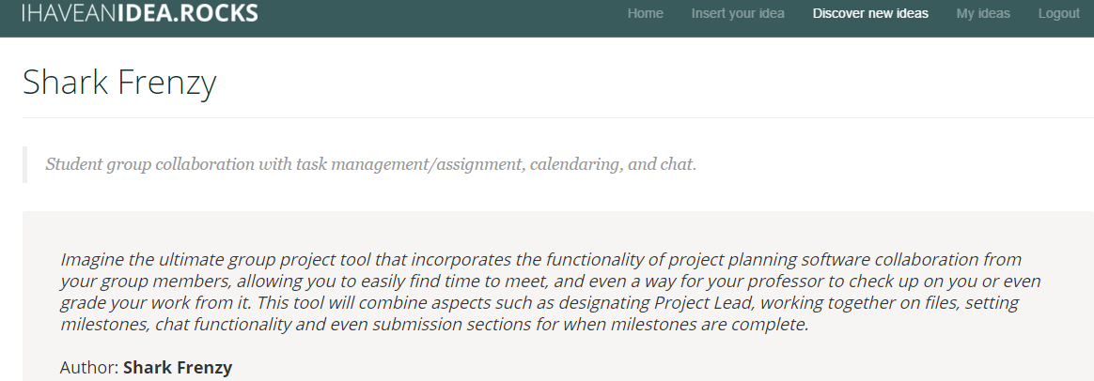
I have an idea
http://ihaveanidea.rocks/project/37/

Slide 4
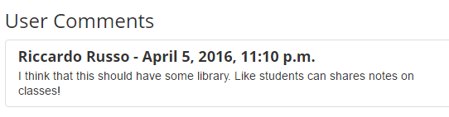

Slide 5
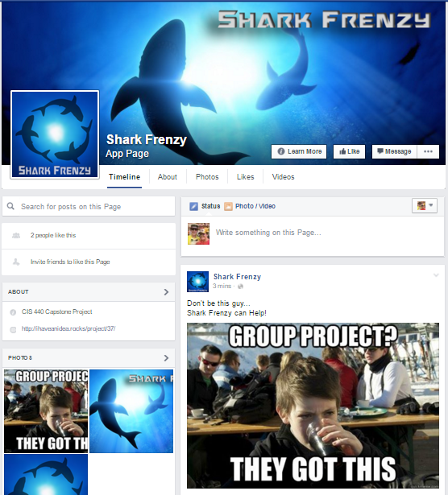
Facebook
https://www.facebook.com/SharkFrenzyApp

Slide 6
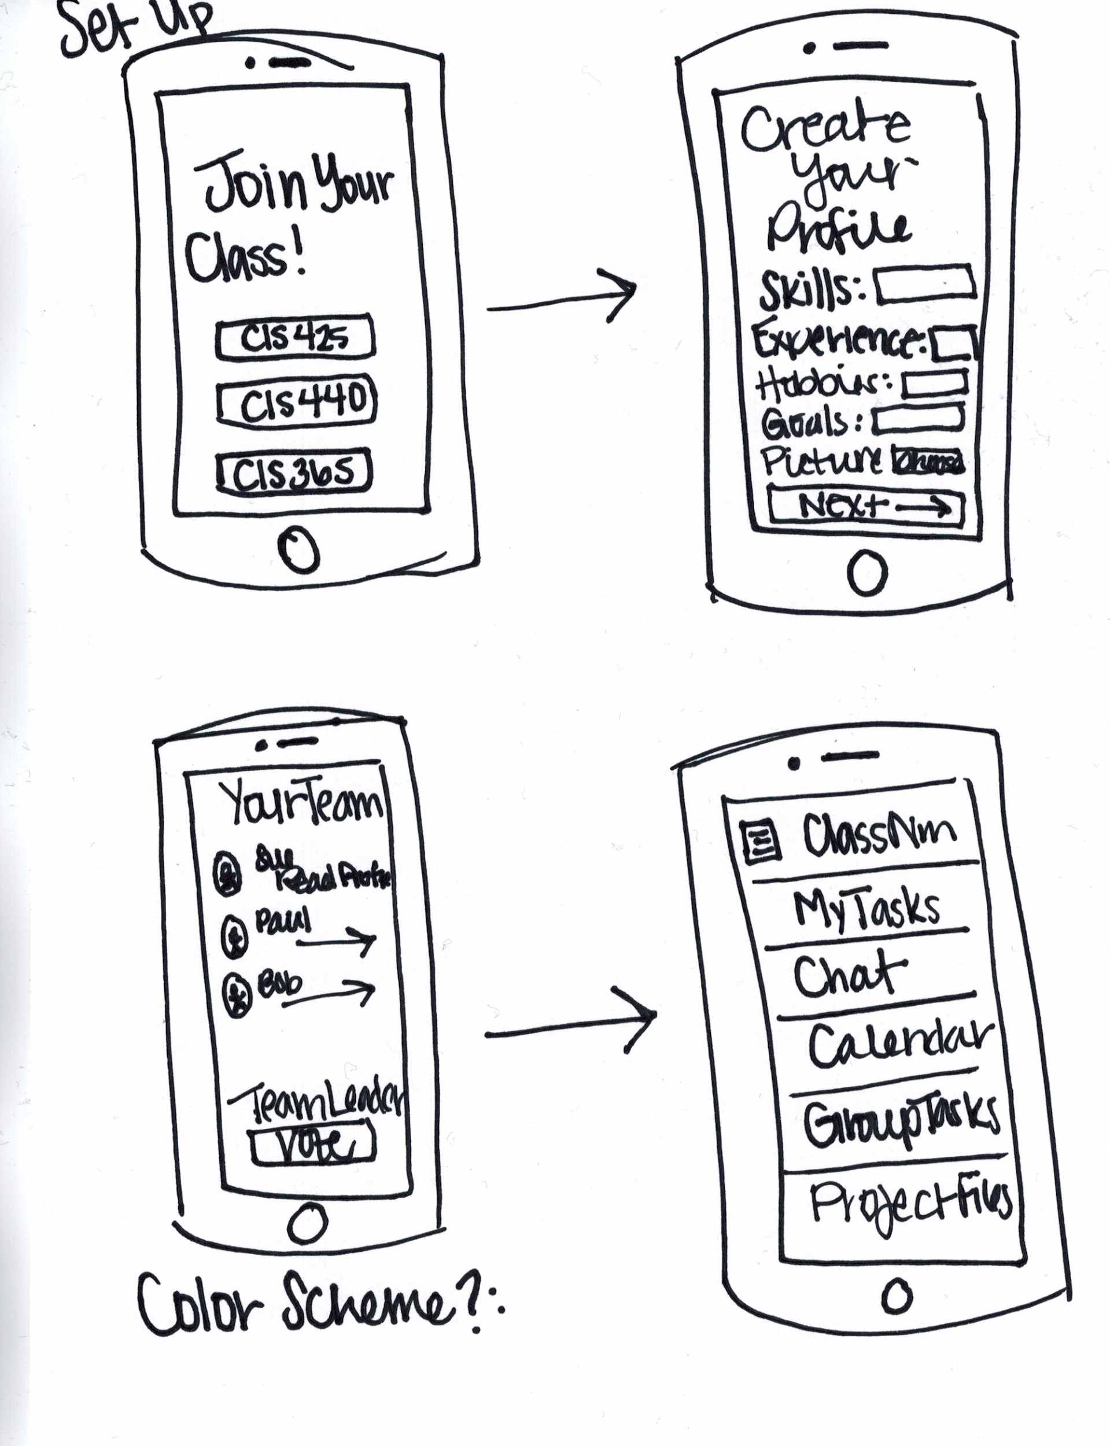
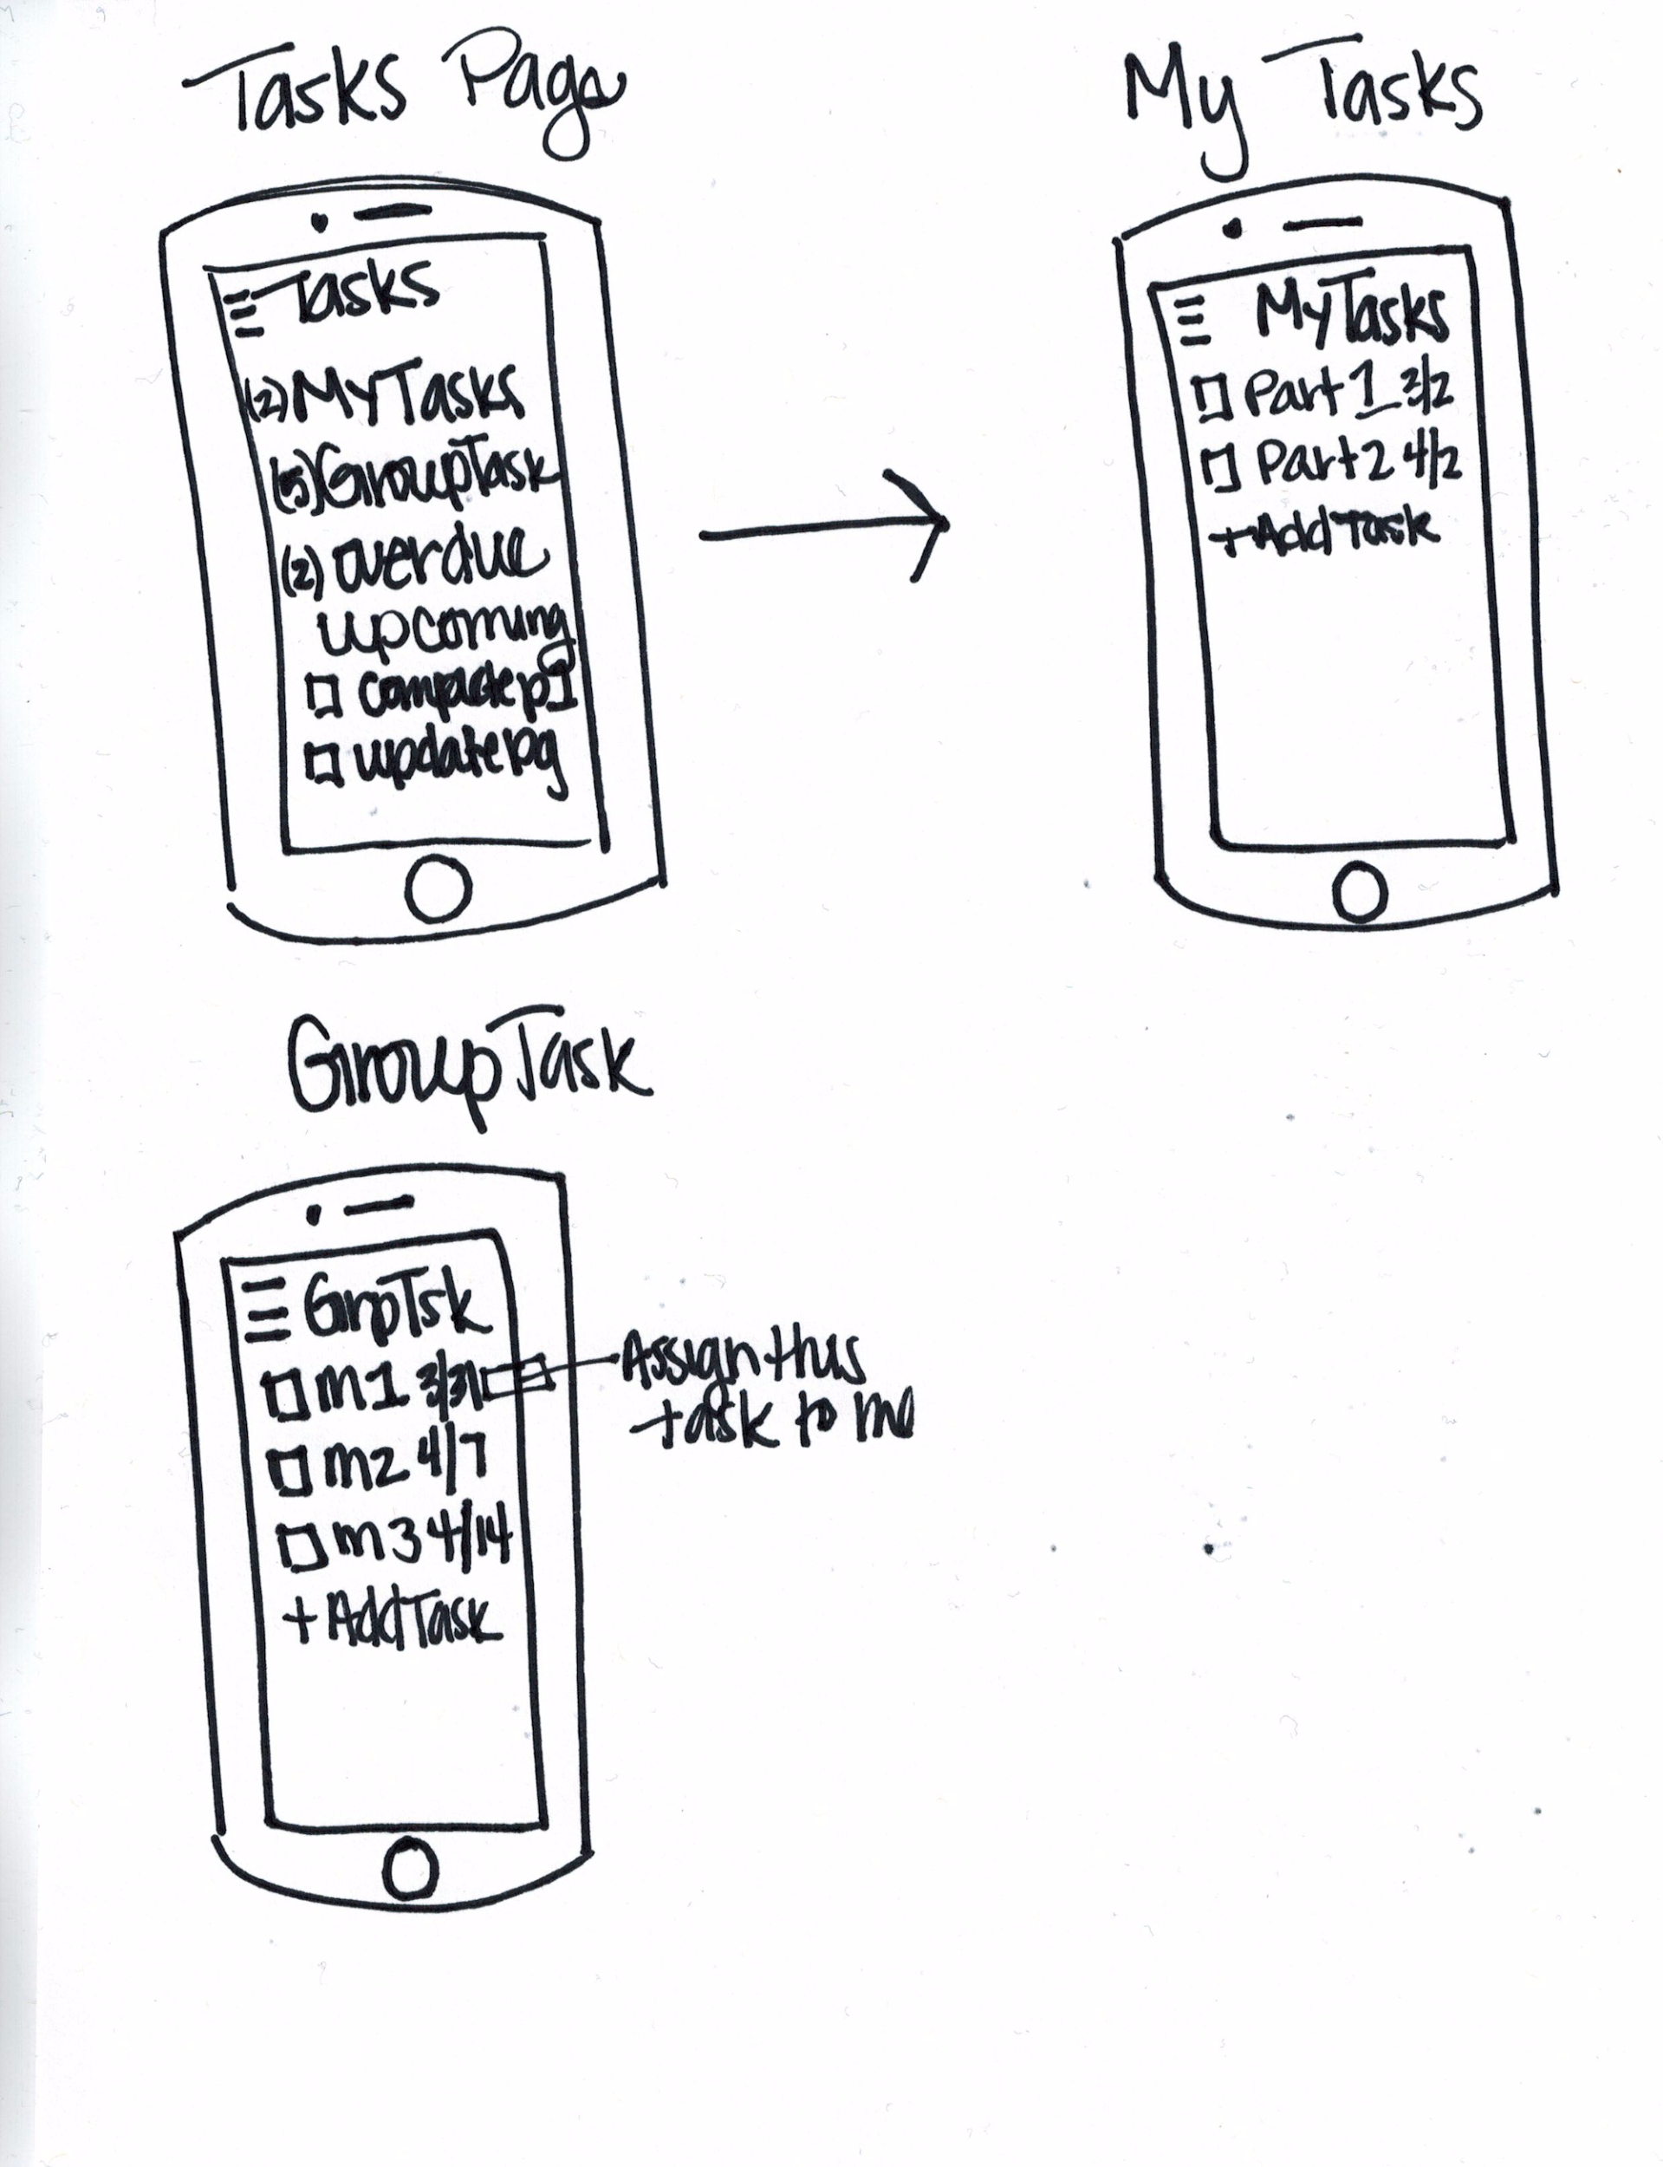
Drafting the App

Slide 7

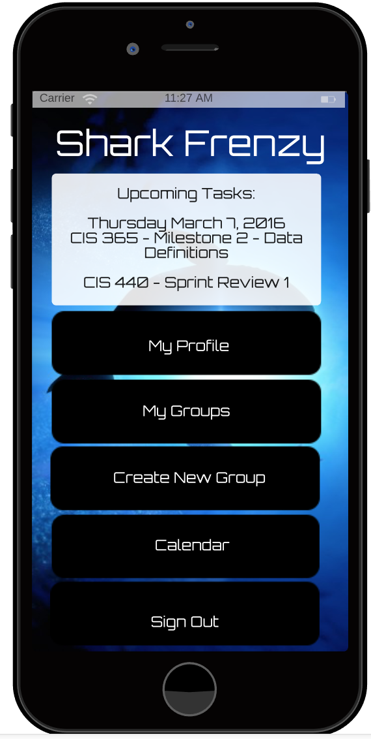
Shark Frenzy

Slide 8
Project Measurements
#1 % of surveyed users who sign up
#2 % of users that create a group project
#3 % of users that were invited by another user to join a group project
#4 % of groups that create a milestone
#5 % of groups that create a milestone task
#6 % of milestone tasks marked as completed
#7 % of milestone marked as completed
#8 % of projects marked as completed
#9 % of users that use group chat
#10 % of users that create multiple projects

